Slide 1
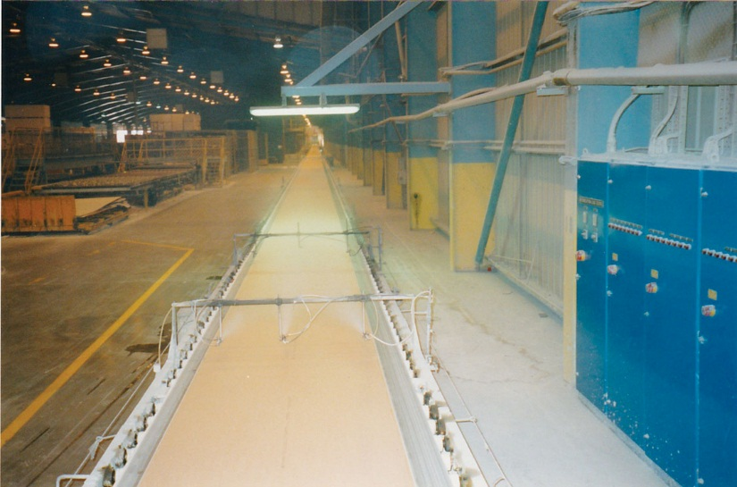
FIGURE 7.1 Plasterboard Manufacture

